Slide 1
Let’s chat
Arbind Kumar Mehta
Mahesh Chandra Verma
Anushka Pokharel

Slide 2
Introduction
Let’s chat is a computer version messenger
It creates conversation between users within specified network and can be used to transfer small files
It is written using object-oriented programming approach(C++)
Various libraries(like windows.h, winsock2.h) has been used to make this project

Slide 3
Objective
To create conversation between specific group of people in secure manner

Slide 4
Methodology
Basic data types of C++ and general object-oriented programming approach provided by C++.
“winsock2.h” library for socket programming
“thread” for handling multiple processes
“mysql.h” for handling user information
“fstream” for file handling and storing previous conversation
“base64” for encoding and decoding data for transfering
Win32 API for graphics and interacting with operating system

Slide 5
Server
User info(MySQL):
Username, password, email, ip, port, remark
Old messages(.txt)
Old messages(.txt)
Request with id and password
Listening to incoming connection
Client 1
Client 2
Create own server
Provide active user info
Create own server
Start new thread
Select friend
Accept conn. If matched
Listening to incoming connection
Listening to incoming connection
Request with client 1
IP and Port
Start new thread
Start new thread
Listening to client 2
Listening to connected client
Listening to client 1
Connection request to client 1
Send and receive messages

Slide 6
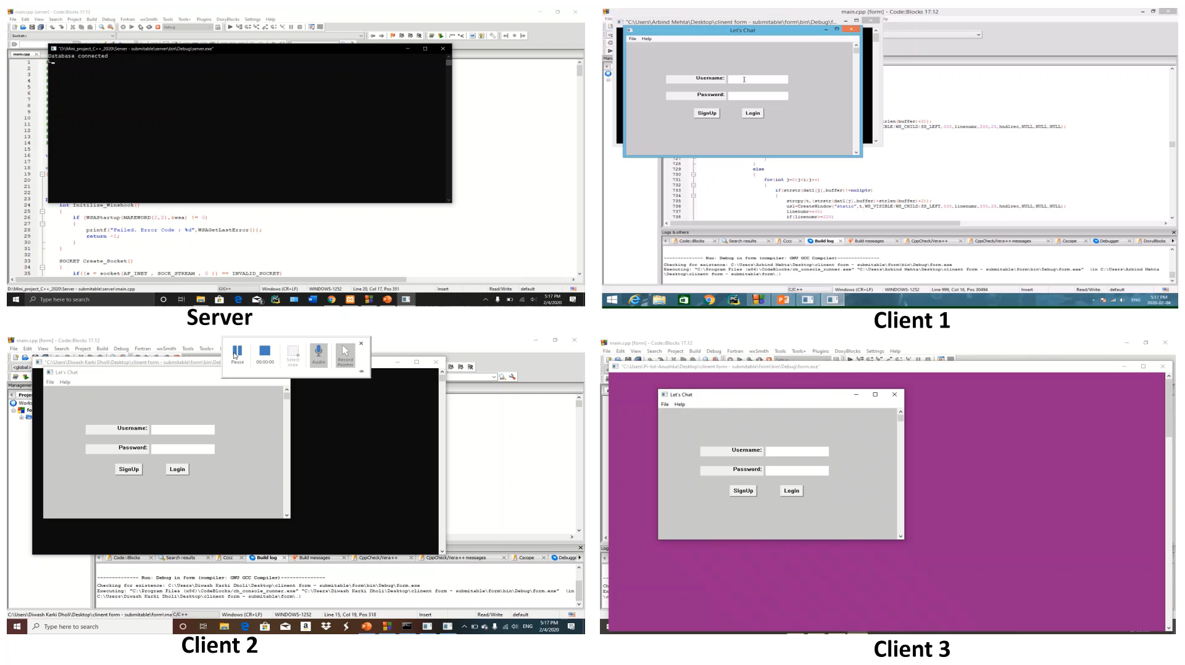

Slide 7
Advantages
User can create their own account.
User can send text and image to their friends.
Keep record of previous conversation.
Handle multiple user at a time.
User can see the list of active users and create more conversation.
Is secure as information remain in local server of organization only.
Main server can be isolated during conversation

Slide 8
Limitations
Cannot send large files
Is specifically design for organization’s network only
For receiving message user must be active
Is platform dependent(i.e. run on Windows only)

Slide 9
Any Question?

